Slide 1

Architecture Alignment
Chapter 9

Slide 2
9 – Architecture Alignment
9.1 Introduction
9.2 The GRAAL Alignment Framework
  9.2.1 System Aspects
  9.2.2 The Aggregation Hierarchy
  9.2.3 The System Process
  9.2.4 Refinement Levels
  9.2.5 Comparison with Other Frameworks
9.3 Alignment Phenomena
  9.3.1 Service Provisioning Layers
  9.3.2 Infrastructure Architecture
Notes:
Aggregation : tổng hợp , tập hợp
Aspects : diện mạo bên ngoài
Alignment : canh chỉnh , liên kết
Provision : dự phòng , dự trữ
Phenomena : hiện tượng

Slide 3
9 – Architecture Alignment
Architecture alignment is the problem of designing architectures at the infrastructure, application, and business levels such that each fits optimally with the other architectures.

Slide 4
9.1 Introduction
Our goal is to derive operational guidelines for aligning IT architecture with business architecture. At the time of writing, we have performed six case studies in various organisations.
The idea at the start of the project was to derive guidelines in the form of patterns of well-aligned software applications that occur in different organisations.

Slide 5
9.2 The GRAAL Alignment Framework
In order to be able to do a comparative analysis, we need a conceptual framework that allows us to describe in a uniform manner any alignment phenomena we find in different organisations

Slide 6
A conceptual framework is a collection of concepts and relations among them that can be used to describe phenomena. After almost ten years of using the framework in describing IT architectures, the framework is now reduced to four simple dimensions.
  System aspects: externally observable properties.
  System aggregation: the composition of complex systems from simplersystems.
  Systems process: the life of a system from creation to disposal.
  Description levels: refinement.

Slide 7
9.2.1 System Aspects
An analysis of a large number of software design techniques has resulted in a simple classification of relevant software aspects, shown in Fig. 9.1 (Wieringa 1998b). A system offers services to its environment; quality properties characterise the value that the system provides for stakeholders by the services it offers.

Slide 8
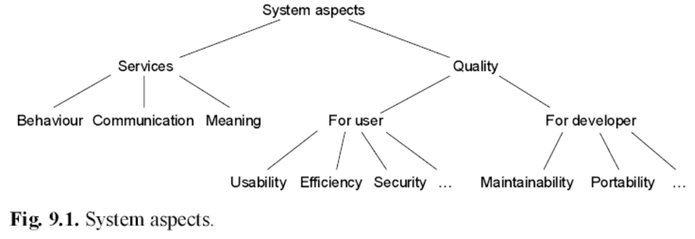

Slide 9
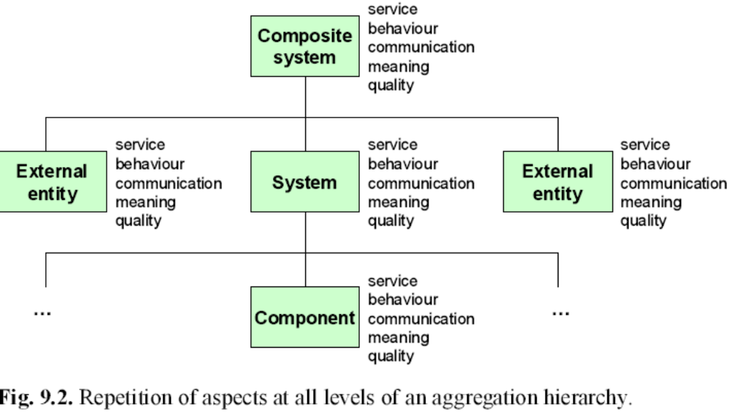
9.2.2 The Aggregation Hierarchy

Slide 10
Rethinking the concept of aggregation, we identify the following two characteristic features :
Rethinking the concept of aggregation, we identify the following two characteristic features (Wieringa 2003, p. 234). Consider a component C of an aggregate A. To say that C is a component of A means the following:

Slide 11
  Service provisioning: C provides a service to A. In other words, C plays a role in the realisation of the services of A itself.
  Encapsulation: An external entity, i.e., an entity that is not a component of A, can only interact with C through the interface of A. In the physical world, this means that A provides a protective cover for C. In the social world, this means that C is ‘owned’ by A, so that an interaction with C is always also an interaction with A. In the symbolic world of software, this means that an interaction with C requires interaction with the interface offered by A to its environment.

Slide 12
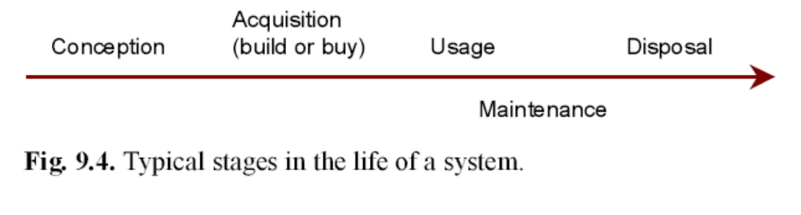
9.2.3 The System Process
The third dimension of the GRAAL framework consists of the stages that a system goes through in its life, from conception to creation, use, and disposal

Slide 13
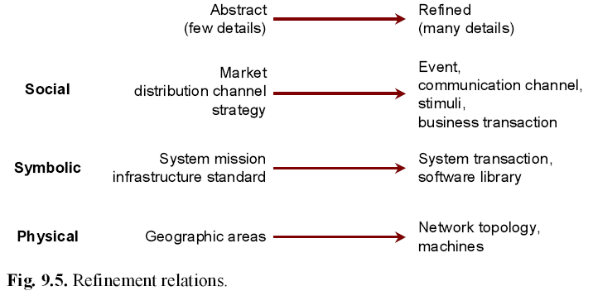
9.2.4 Refinement Levels

Slide 14
9.2.5 Comparison with Other Frameworks
Zachman distinguishes three kinds of descriptions, the data, process, and network description which correspond, roughly, to our meaning, behaviour, and communication aspects.
Kruchten’s 4+1 model (Kruchten 1995), described in Sect. 7.1.3, defines the logical and process views of a software system, which correspond roughly with our aggregation dimension and behaviour view, respectively.
The two basic abstraction operations of focusing on aspect systems and focusing on a subsystem correspond to the two semantic data modelling operations of generalisation (reducing the number of aspects considered) and aggregation (considering an overall system)

Slide 15
9.3 Alignment Phenomena
In the various case studies we have carried out, we have attempted to identify general alignment phenomena. In the next subsections, we present our observations.
We formulate a number of propositions that try to generalise from these observations.

Slide 16
9.3.1 Service Provisioning Layers
All cases studied by us use a layered architecture that distinguishes at least software applications from software infrastructure. Our generalisation of the many different examples that we saw is shown in Fig. 9.6.

Slide 17
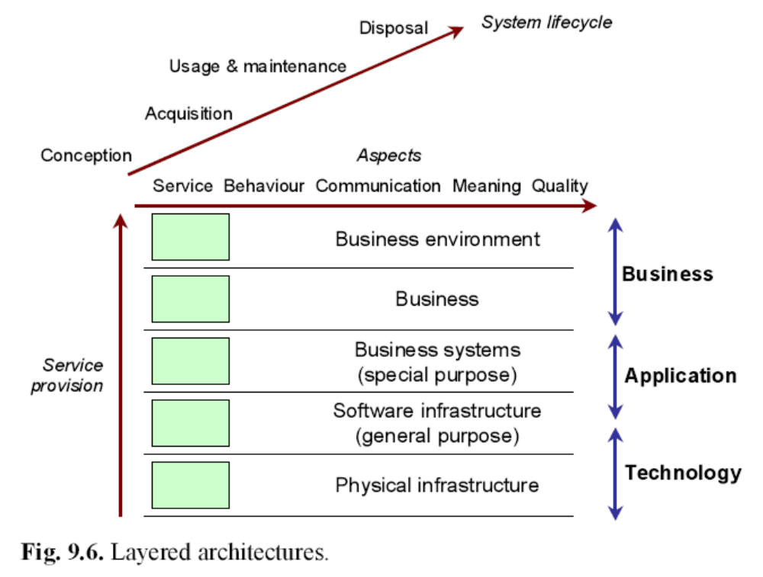

Slide 18

This figure gives a three-dimensional classification of system views, which we used in all our case studies. The success in using this framework to analyse IT architectures in different organisations leads us to our first proposition:

Slide 19
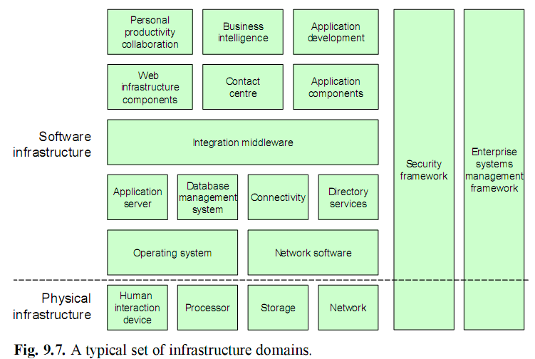
9.3.2 Infrastructure Architecture

Slide 20



Slide 21
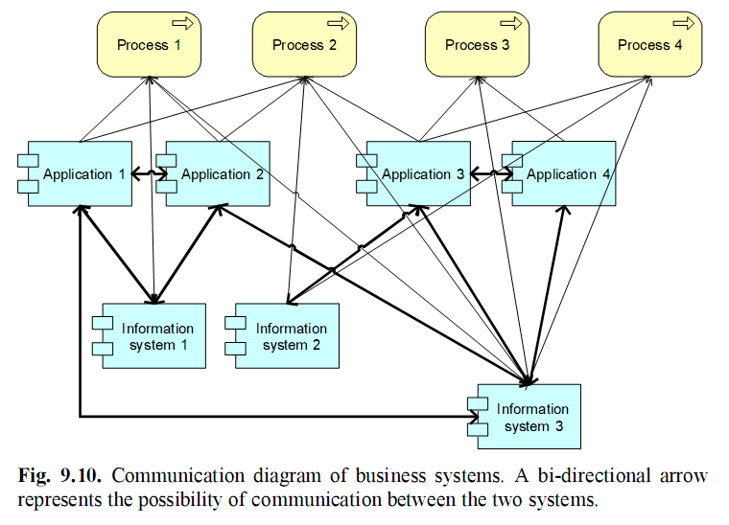
9.3.3 Business System Architecture

Slide 22
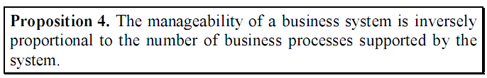

Slide 23
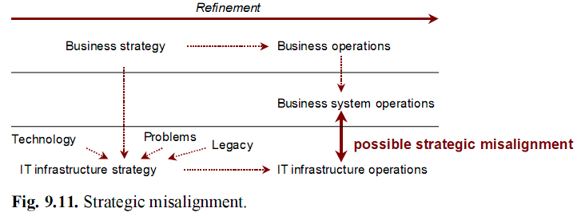
9.3.4 Strategic Misalignment

Slide 24
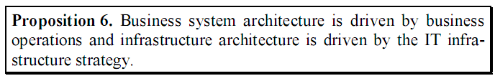
The result is a strategic misalignment that is hard to repair. This misalignment is aggravated because the business system development process is usually out of phase with the infrastructure development process. Business systems are (re)developed when the business calls for it; for example, because users ask for it.

Slide 25

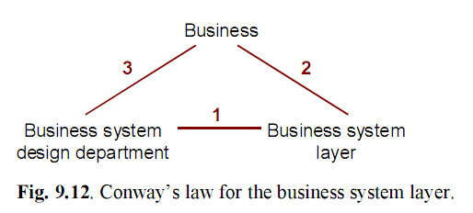
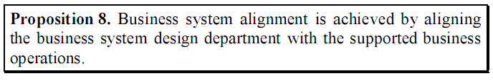
9.3.5 Conway’s Law

Slide 26
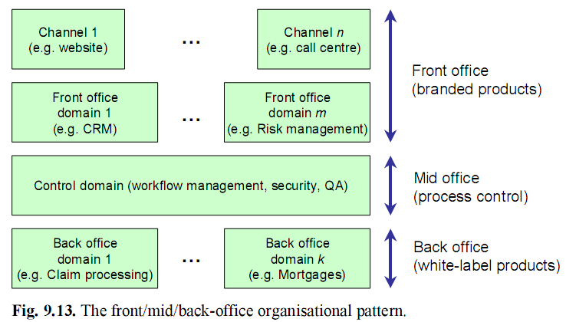
9.3.6 The FMO Alignment Pattern

Slide 27
9.4 The Architecture Process
Alignment is not just a matter of correctly coupling the diverse types of
systems in the social, symbolic, and physical worlds of an enterprise, but
also a matter of adjusting the development and management processes re-
sponsible for these systems.

Slide 28
9.4.1 Methods
The architecture design methods in the organisations studied by us were all based on information engineering, itself a method developed in the 1970s (Martin 1982, 1989, van der Sanden and Sturm 1997).

Slide 29
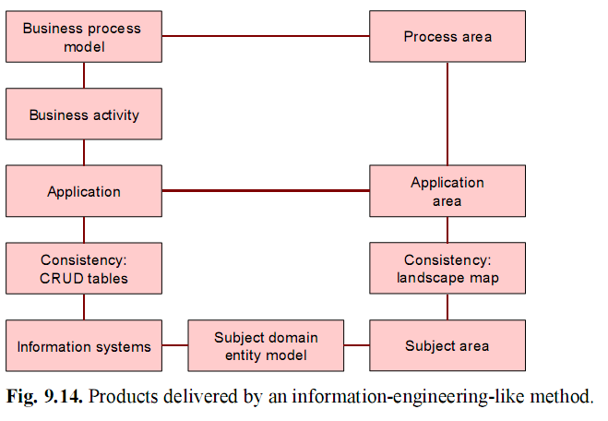

Slide 30
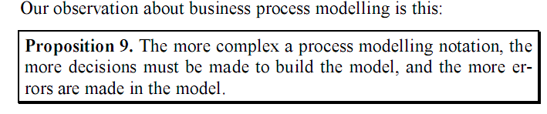

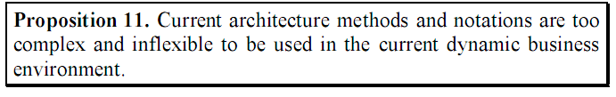

Slide 31
9.4.2 IT Governance
IT governance is the activity of controlling IT. It consists of making decisions about acquisition, change, and disposal of IT, as well as monitoring IT performance data in order to be able to control IT more effectively and efficiently. IT governance is part of corporate governance.

Slide 32
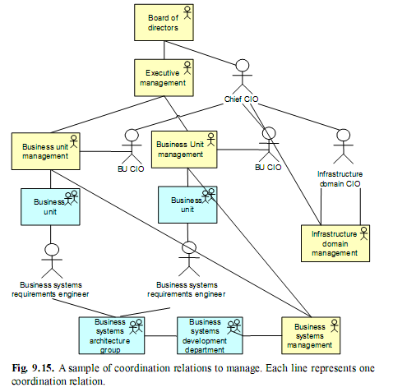

Slide 33

The architecture of a business system layer is designed with global cost reduction in mind. This always requires reuse of components in different systems, or the imposition of standards that globally make sense but locally may seem awkward to follow.
When an individual system is designed, the project manager or business unit manager responsible for the project will always find good reasons why this globally optimal design is not optimal for his or her system, and will try to get around the global architecture.
The only way around this tension is to make the project manager directly accountable to someone responsible for maintaining the global architecture, such as the chief CIO in Fig. 9.15.

Slide 34
9.5 Summary
We presented a framework for describing alignment phenomena consisting of three system dimensions: system aspects (services, behaviour, communication, semantics, and quality), system aggregation, and system life cycle states.
In all these organisations, IT architecture has a layered service provision structure. The infrastructure layer contains systems that must be available for all users; the business system layer contains systems available for particular business processes.

Slide 35
9.5 Summary
Business systems have a tendency to gravitate towards the infrastructure layer. Because infrastructure is driven, among others, by the business strategy, and the business system layer is driven primarily by the actual business operations, there is usually a misalignment between these two layers.
Most organisations structure their infrastructure layer into a number of technology domains, and structure their business system layer into a number of business domains.
This roughly corresponds to a front/mid/back-office structure where the front office contains the business-specific systems and the back office contains generic, white-label systems.

